Slide 1
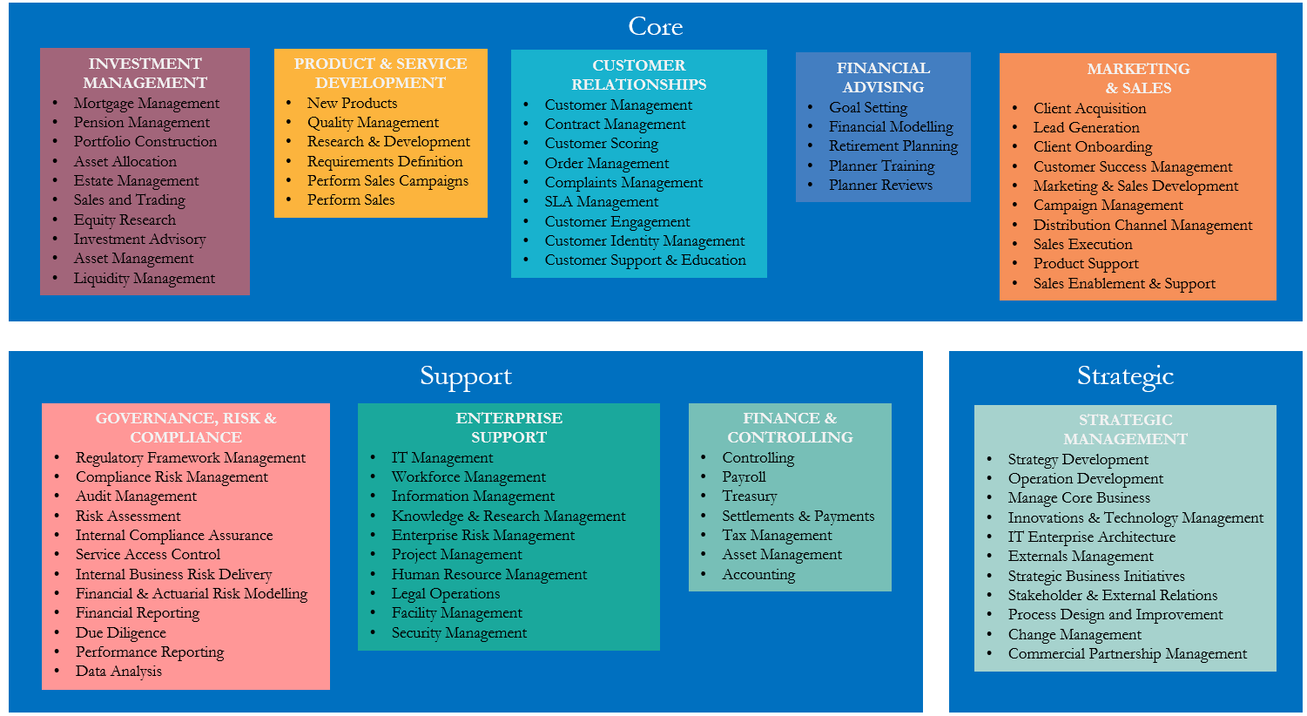
Architect
January 2025
Version 0.1

Slide 2
Capability Map
What is a Capability Map?
A Business Capability Map is a model that visually shows an organisation’s business activities, abilities and functions, regardless of the organisation’s structure, or the processes, resources and people used to execute these activities.
What do we use a Capability Map for?
A Capability Map allows leaders to identify strengths, weaknesses, and areas for improvement in the business.
It highlights where to invest resources to develop necessary capabilities and achieve organisational goals.
It is a starting point for creating a business roadmap for future activities and a supporting technology roadmap.
With a technology roadmap, one can generate an IT Strategy.
A Capability Map can also be used to illustrate the business impact that a single new IT initiative may have on the business.
It is a Common Language Bridge between the business community and the IT community
It is also a common basis for discussion and planning.

Slide 3
Capability Map
Core
INVESTMENT MANAGEMENT
Mortgage Management
Pension Management
Portfolio Construction
Asset Allocation
Estate Management
Sales and Trading
Equity Research
Investment Advisory
Asset Management
Liquidity Management
PRODUCT & SERVICE DEVELOPMENT
New Products
Quality Management
Research & Development
Requirements Definition
Perform Sales Campaigns
Perform Sales
CUSTOMER RELATIONSHIPS
Customer Management
Contract Management
Customer Scoring
Order Management
Complaints Management
SLA Management
Customer Engagement
Customer Identity Management
Customer Support & Education
FINANCIAL ADVISING
Goal Setting
Financial Modelling
Retirement Planning
Planner Training
Planner Reviews
MARKETING
& SALES
Client Acquisition
Lead Generation
Client Onboarding
Customer Success Management
Marketing & Sales Development
Campaign Management
Distribution Channel Management
Sales Execution
Product Support
Sales Enablement & Support
Support
Strategic
GOVERNANCE, RISK & COMPLIANCE
Regulatory Framework Management
Compliance Risk Management
Audit Management
Risk Assessment
Internal Compliance Assurance
Service Access Control
Internal Business Risk Delivery
Financial & Actuarial Risk Modelling
Financial Reporting
Due Diligence
Performance Reporting
Data Analysis
ENTERPRISE
SUPPORT
IT Management
Workforce Management
Information Management
Knowledge & Research Management
Enterprise Risk Management
Project Management
Human Resource Management
Legal Operations
Facility Management
Security Management
FINANCE & CONTROLLING
Controlling
Payroll
Treasury
Settlements & Payments
Tax Management
Asset Management
Accounting
STRATEGIC
MANAGEMENT
Strategy Development
Operation Development
Manage Core Business
Innovations & Technology Management
IT Enterprise Architecture
Externals Management
Strategic Business Initiatives
Stakeholder & External Relations
Process Design and Improvement
Change Management
Commercial Partnership Management

Slide 4
How to Update this Map
Core business capabilities are mostly stable over time and persist throughout organisational changes. Only major business model updates should affect them, and these changes should be captured in an updated capability map. Here is a guide to update the map:
Define “What”; not “How”
A Business Capabilities Map encapsulates what a business is doing right now.
Add to the map what the business must do to meet current and future challenges.
Distinguish between Core Support and Strategic Capabilities
Core capabilities are the main value-stream activities
Support capabilities are activities needed for the business to run itself
Strategic capabilities measure the business’s market position, setting direction, planning and executing the journey.
Use a hierarchical map
Break down the complexity by grouping capabilities into no more than 3 levels deep.
The highest-level capabilities should completely describe the business.
Don’t overlap capabilities, they should be mutually exclusive.
Ignore Business Units / “Departments”
Capabilities should remain the same and be independent of the ever-changing organisation structure.

